Slide 1
Predicting NBA player improvement
Dhananjai Govind
Ra1811031010006
csE-it “k-1”

Slide 2
Predicting player improvement is valuable for NBA teams
Generally, players are valued by their past performances. Therefore, players who improve a lot bring both competitive and economic advantages to teams.
Such value is recognized by NBA: Most Improved Player award.
Predicting player improvement help team management.
  Target players to acquire/release
  Plan for performance changes of players already on the team
Fans have interest as well (fantasy basketball)

Slide 3
Data acquisition and cleaning
Player age, team and performance data (1980-2017) from Kaggle dataset, 2018 data scraped from basketball-reference.com
Player draft position data (1978-2015) from Kaggle dataset, 1965-1977, 2016-2017 data scraped from basketball-reference.com
In total, 13,378 rows and 49 features in the raw dataset.
Duplicate, highly similar or highly correlated features were dropped.
Cleaned data contains 24 features.

Slide 4
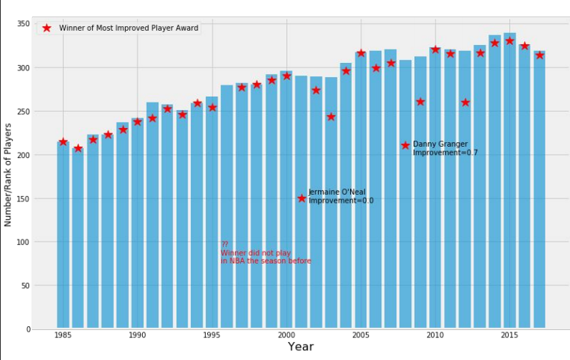
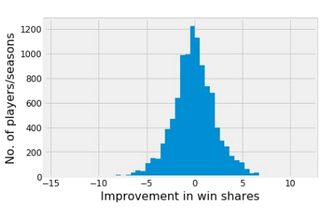
Using ΔWS (win shares) as improvement measure

Slide 5
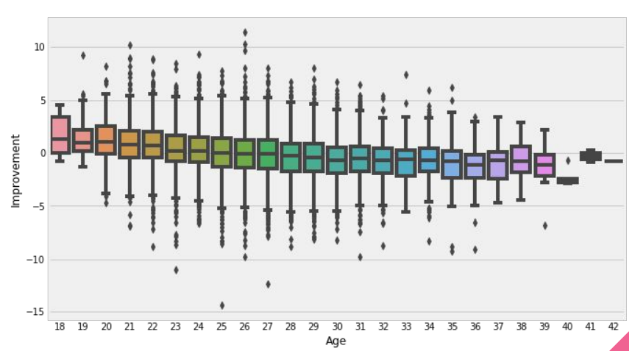
Young players improve, old players decline
Improvements of different age groups(<25,25-29,,30-34,>34) were significantly different from each other. (p<0.001)

Slide 6
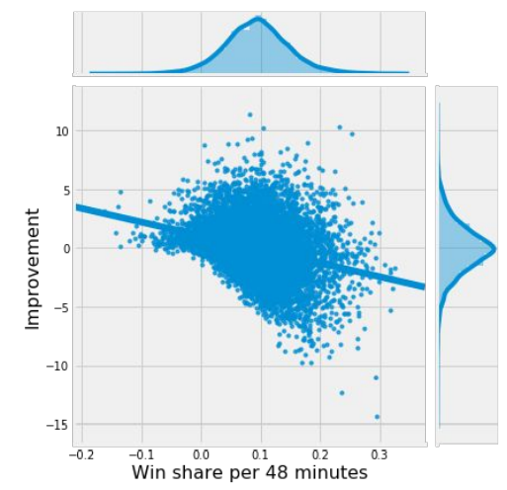
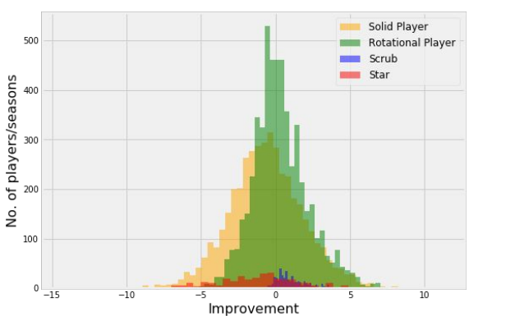
Worse players have more room for improvement

Slide 7
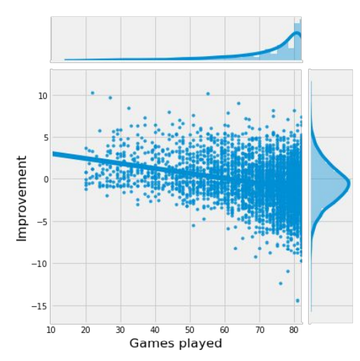
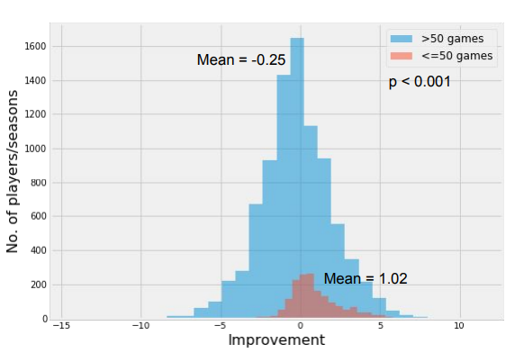
Players who missed more games are more likely to improve

Slide 8
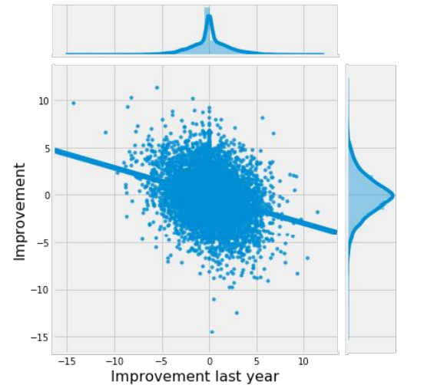
Players are more likely to “regress to the mean” than continuously improve/decline
Also examined other features and hypotheses, including:
  Minutes played (slight negative correlation with improvement)
  Player positions (no significant difference)
  Player draft positions (no significant difference)
  Team performance (very small negative correlation)

Slide 9
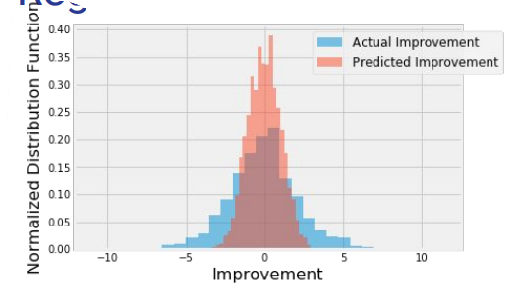
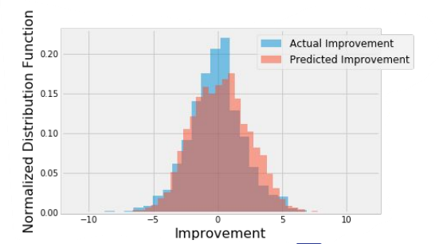
Regression models: dealing with unbalanced dataset
Players with small changes are overrepresented.
Unweighted model prioritize the error of those players.
Resulting in narrower predicted range.
Assigning more weights to underrepresented players help with this problem.
Equal weights
Different weights

Slide 10
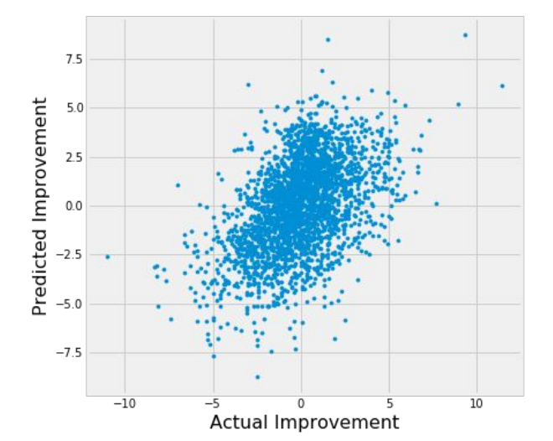
Regression models performance
Weighted RMSE:
  Benchmark (1 feature): 3.84
  Linear regression: 2.98
  SVM: 2.86
  Random Forest: 2.93
  Gradient Boost: 2.96

Slide 11
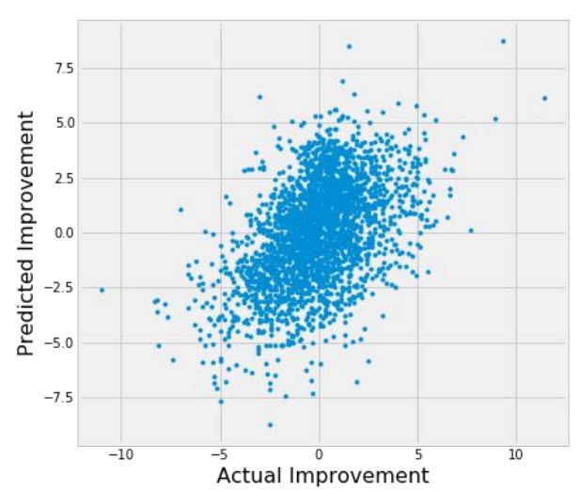
Classification models
Log loss:
  0.603-0.613 between 5 models
Accuracy:
  0.672-0.675 between 5 models
SVM performed best among single algorithms, but the differences were small.

Slide 12
Conclusion and future directions
Built useful models to predict whether and how much a player will improve.
Accuracy of the models has room for improvement.
Capture more of players’ individual traits.
Ideas include:
  Physical data (speed, jump, etc.)
  Financial data (contract year, amount of pay, etc.)
  Team interaction data (strengths of players of the same position on the team)

Slide 13
THANK YOU

